Slide 1



Intellect University
App Icons
v.24082
Notes:
ALT: Intellect Elevates Organizational Excellence with Next-Gen Quality Solutions

Slide 2
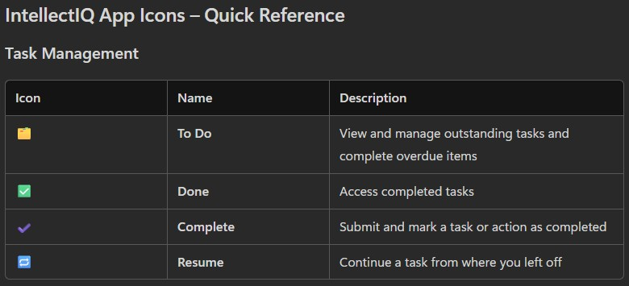
Task Management

Slide 3
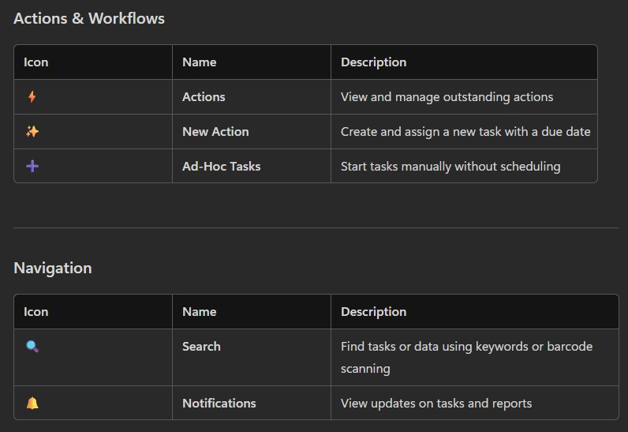
Actions, Workflows & Navigation

Slide 4
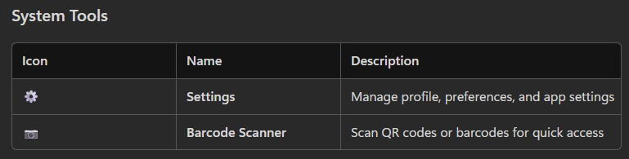
System Tools

