Slide 1




IntellectIQ Platform

Slide 2

IntellectIQ Platform – Powered by AI
IntellectIQ is Quality, Execution, and Compliance in a Unified Manufacturing Platform
Quality Management
Frontline Operations
Workplace Risks
Quality Management System
Connected
Frontline Worker
Environmental, Health, & Safety

Slide 3


Empowering Excellence for Manufacturers Globally
Embedding standards and best practices into everyday execution
Manufacturing Leaders Trust Intellect
Notes:
Intellect has spent 25+ years helping Manufacturing and Life Sciences organizations elevate compliance, efficiency, and performance. Our no-code platform empowers teams to adapt quickly, automate workflows, and meet stringent ISO, FDA, and GxP requirements. When paired with Zaptic, customers get both world-class compliance management and seamless execution on the factory floor.
Zaptic gives frontline teams the digital tools they need to work smarter—things like work instructions, skills tracking, issue reporting, and shop-floor collaboration. Customers use Zaptic to resolve issues faster, improve handovers, and eliminate paper. It brings real-time connection to what operators are doing day to day. When combined with Intellect, we bridge the gap between standards and frontline actions.

Slide 4
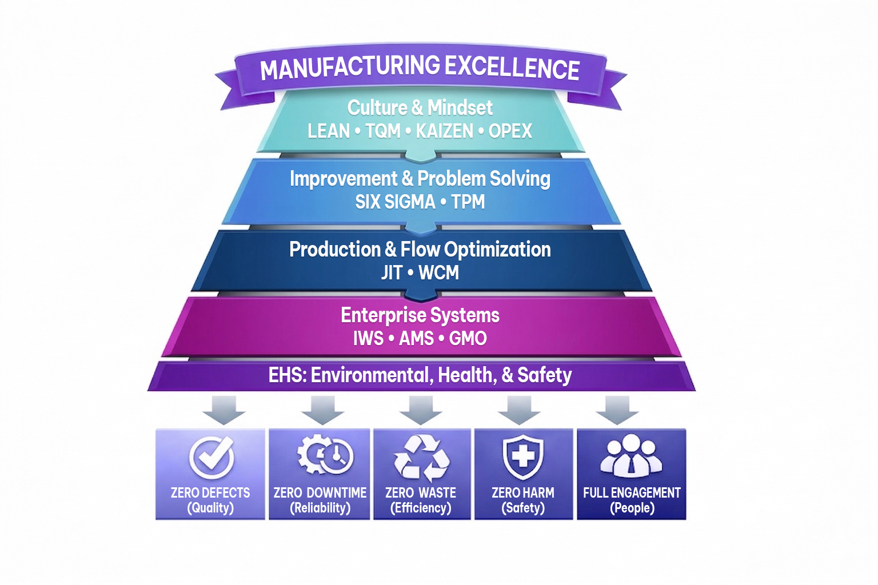
IntellectIQ Platform
Ensures Manufacturing Excellence for Global Manufacturers
100% compliance

Slide 5

Results Are Transformative
Scaling Quality and Operations Globally
Ensuring Compliance Frameworks
  FDA, GDPR, ISO 9001, ISO 27001
Real-Time AI and Expert Chat Help
Continuous Improvement for Optimization of QMS
Employee Training Modules
AI Efficiency for Closed-Loop Operations
Use Case: Carlsberg Group
Notes:
Brewing identical quality across 100+ sites worldwide
Faster changeovers enabling seasonal, craft, and low/no-alcohol variants
Reducing waste, downtime, and hidden inefficiencies
Water and energy use cut by 20%+ per litre in many breweries
Lower incidents and stronger frontline ownership of improvement

Slide 6


IntellectIQ Platform
Closed-Loop Approach Accelerates Compliance
Execution standardized across sites
Intellect Brings it All Together
International Organization for Standardization standards for ISO 9001 and ISO 14001
Supports regulatory readiness for U.S. Food and Drug Administration requirements. Prevents small issues becoming costly failures.
Scale exponentially across sites
Notes:
Quality standard drift without frontline execution

Slide 7

Closing the Quality Manufacturing Loop
Connecting Standards, Execution, and Results
Quality
Management
Frontline Execution
Performance Integration Visibility
Standards
Operator Workflows
MES
Audits
Digital Checklists
SCADA
Maturity Audits
Problem Solving
Analytics
Sharing Best Practices
Training
ERP
The systems that define standards, guide execution, and measure performance are not operating as one continuous, real-time loop. IntellectIQ solves it.

Slide 8


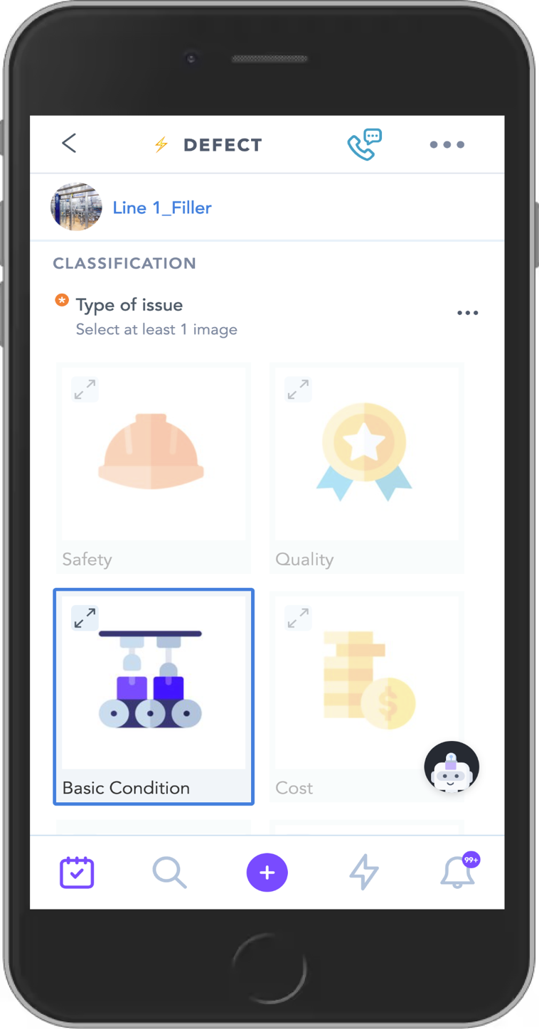
Connected Workers Digitize Frontline Execution

Slide 9


Configurable Quality Management System (QMS) for
Regulated Industries
Features
Document Control
Analytics
ISO-certified
NCRs and CAPA
  IntellectIQ Platform connects every NCR to the actual work, people, and processes involved

Slide 10
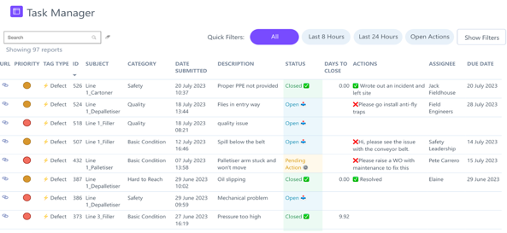
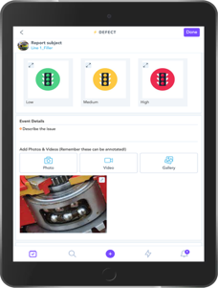
Unified Platform Accelerates Operational Excellence
Intellect aligns seamlessly with your standards and processes
Safety, Health, Environment
Hazard Reports
Incident Reports
Near Miss reports
HSE Audits
S.S.O.W / SOPs
Quality
Internal NCR
Complaints
CAPAs
SOPs
Set Up Sheets
Autonomous Maintenance
CILs
Tagging
Centerlines
Breakdown
analysis
Professional Maintenance
Work Requests
Mobile work order
Planned maintenance tasks and schedule
Focused Improvement
5S
Gemba Walks
Kaizens
SIC
Problem solving
People Development
Training modules
Training delivery
Skill matrixes
Task Management
Knowledge Management
Collaboration
Skill Management
Daily Management Systems
Leadership Routines
Issue Management
SIC & Daily Operations Review Meetings

Slide 11
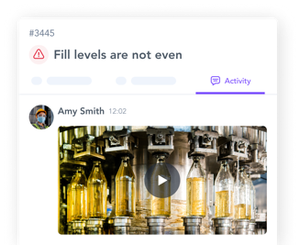
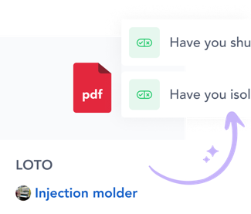
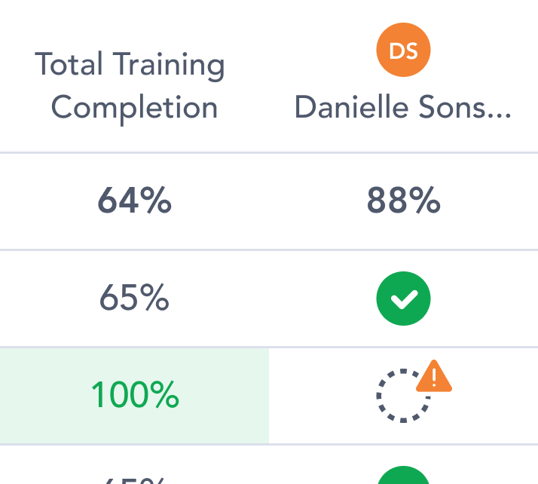
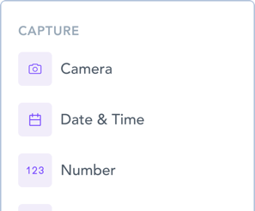




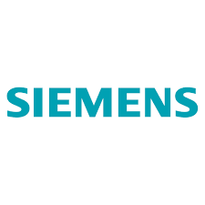
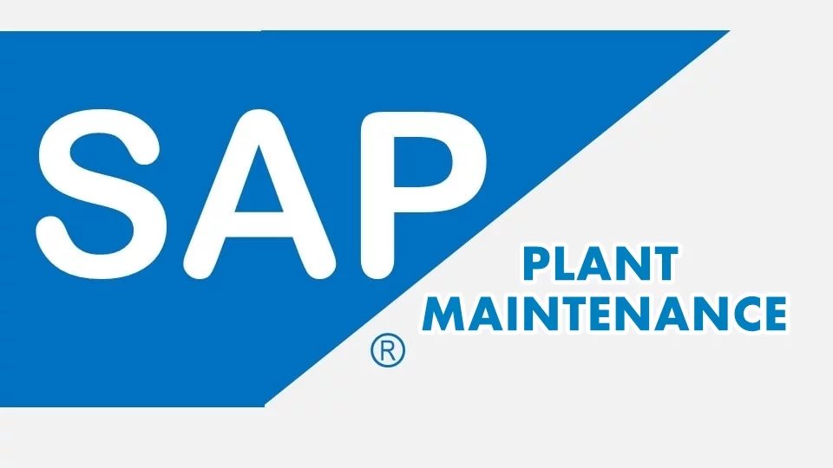





IntellectIQ Platform Integrates Easily with IT and OT Systems
Task Management
Complete no code workflow toolkit for all checklists, inspections, escalations
Collaboration
Daily meetings boards
Communication & messaging
Issue & action tracking
Knowledge Management
Asset centric knowledge base
AI-Powered work instruction
Skill Management
On the job and self paced learning
Training matrices
Embedded AI
AI co-pilot
Conversational analytics
Generative content
Seamless integration with client’s system of record (CMMS,, ERP; LMS, MES,QMS)
Automated & real-time embedded reporting
Streamlined and compliant onboarding process
Seamless Third-Party Integrations
ERP / EAM
MES
Website Hosting

Slide 12
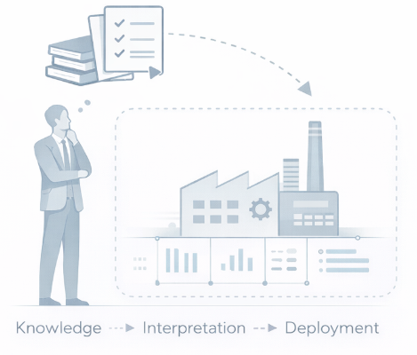
What If Improvement Expertise was
Embedded in the System?
Continuously adapts based on performance
Guides improve actions in real time
Updates standards, workflows and training automatically

Slide 13







IntellectIQ Platform: A Closed Loop for Standards, Execution, and Continuous Improvement
Generative Content
Knowledge sharing
Build & Deploy Capability
Frameworks codify standards,
Define controls and activities (e.g. OEE, AM, FI, CIL)
Deploy guided workflows, training, and document management at scale
3. Improve & Scale
Identify gaps through performance data and AI-driven insights
AI helps update standards, workflows and training
Guide teams with adaptive actions — and scale across sites
AI Operator Assistant
2. Execute & Monitor
Guided Daily Management Systems
Continuous, Real-time data and evidence
Integrated with performance systems (MES, IoT) to monitor outcomes
Notes:
This slide shows how IntellectIQ closes the loop most manufacturers struggle with.
We centralise standards and governance, we embed them directly into frontline execution, and we continuously improve them based on what actually happens in operations.
AI sits in the middle to accelerate learning, updates, and insight — but the value comes from execution first.
That’s how we make compliance preventative, lean sustainable, and improvement continuous

Slide 14
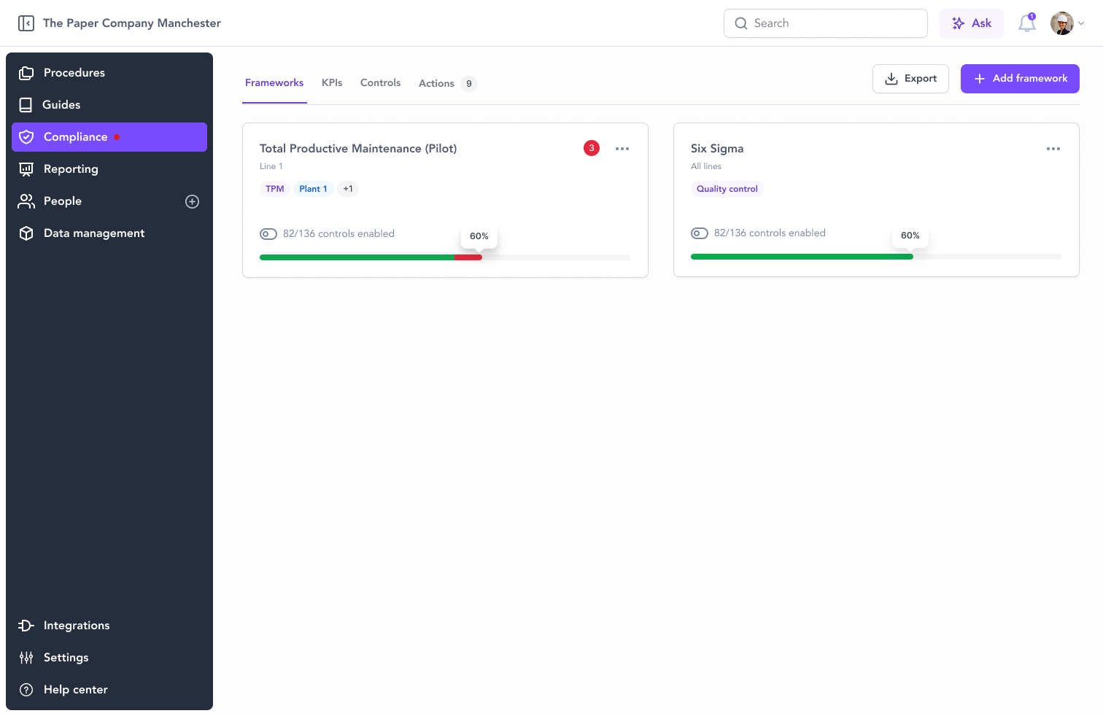
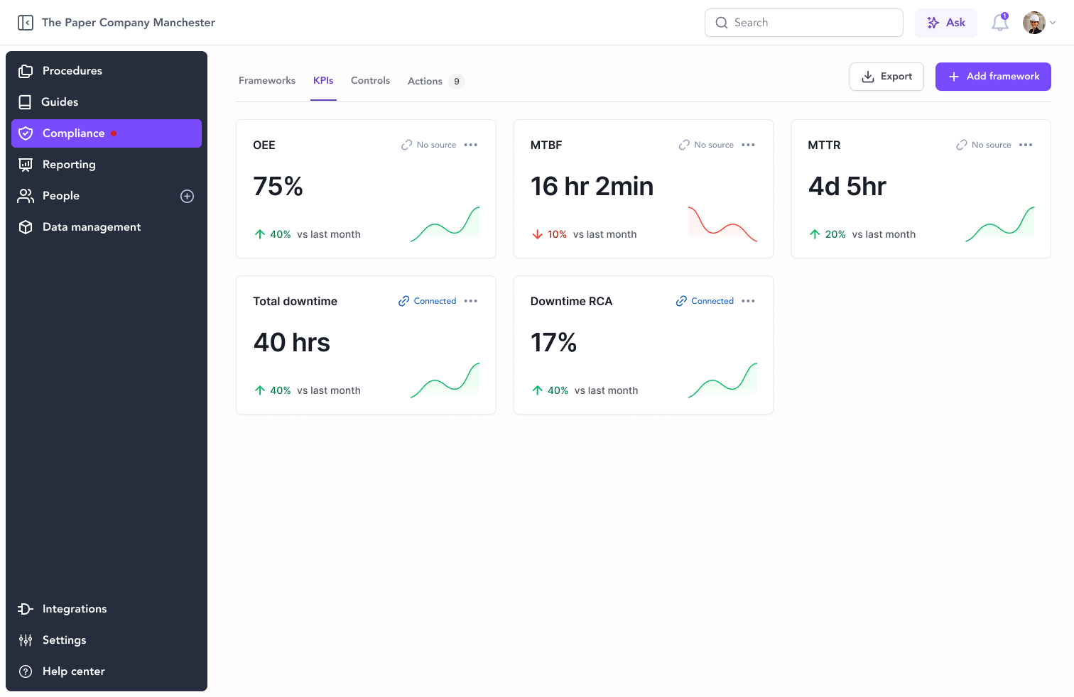

IntellectIQ Platform Dashboards

Slide 15
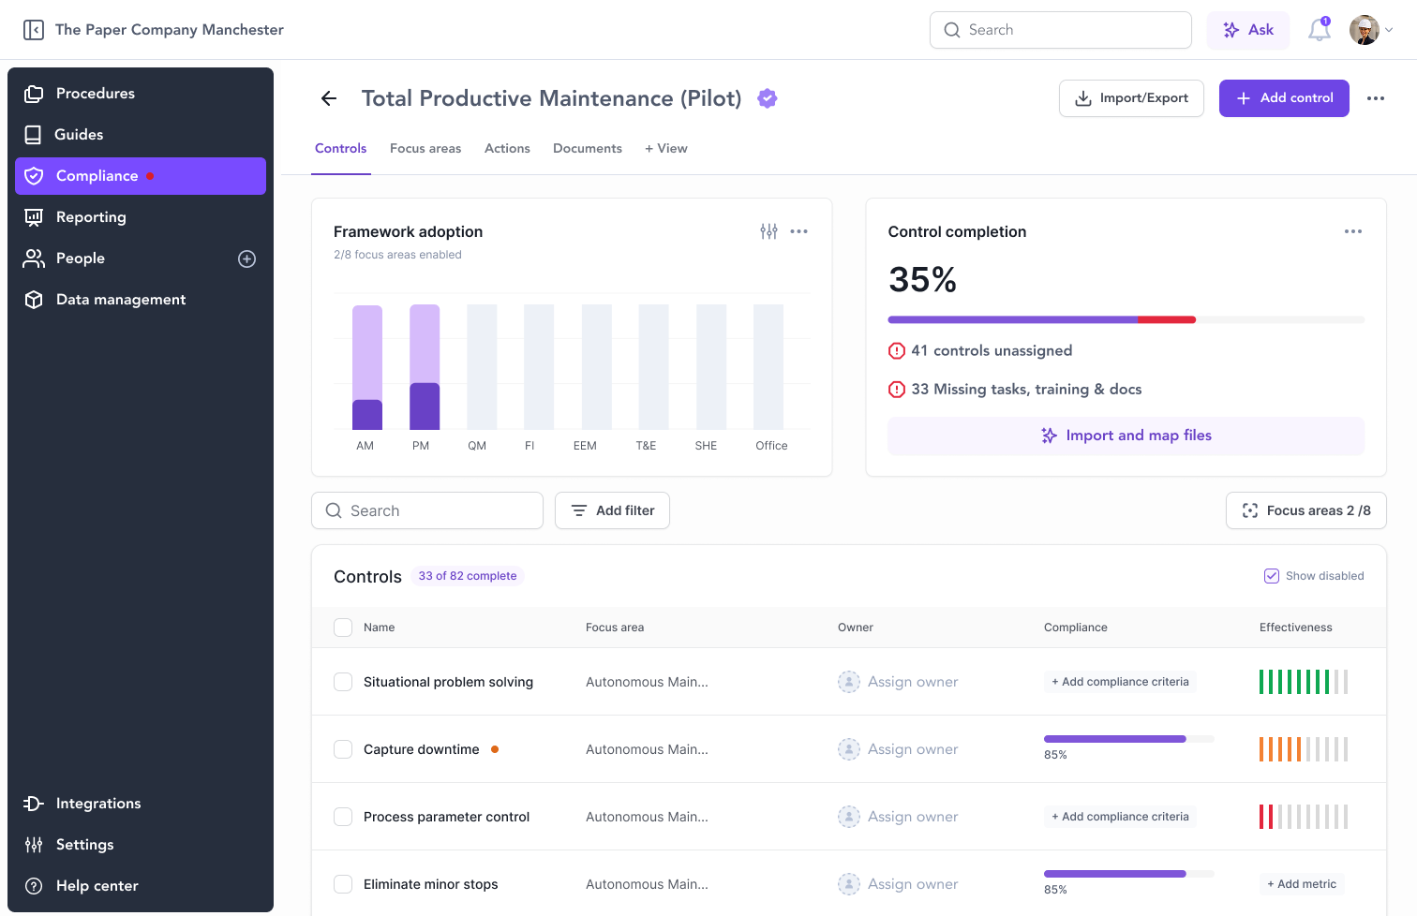
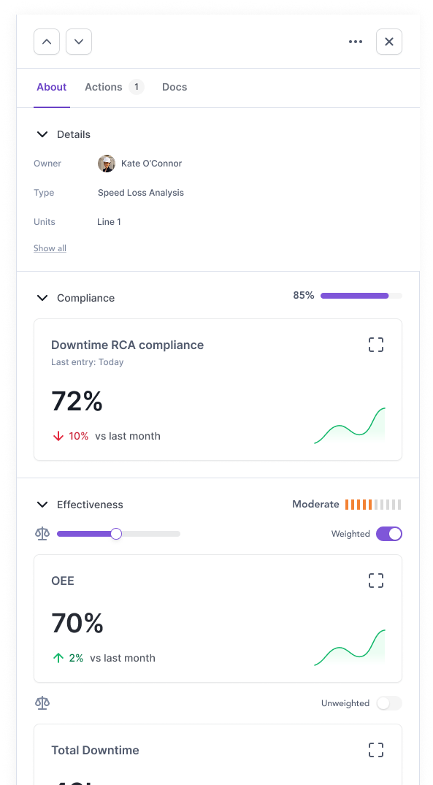
IntellectIQ Platform Dashboards

Slide 16
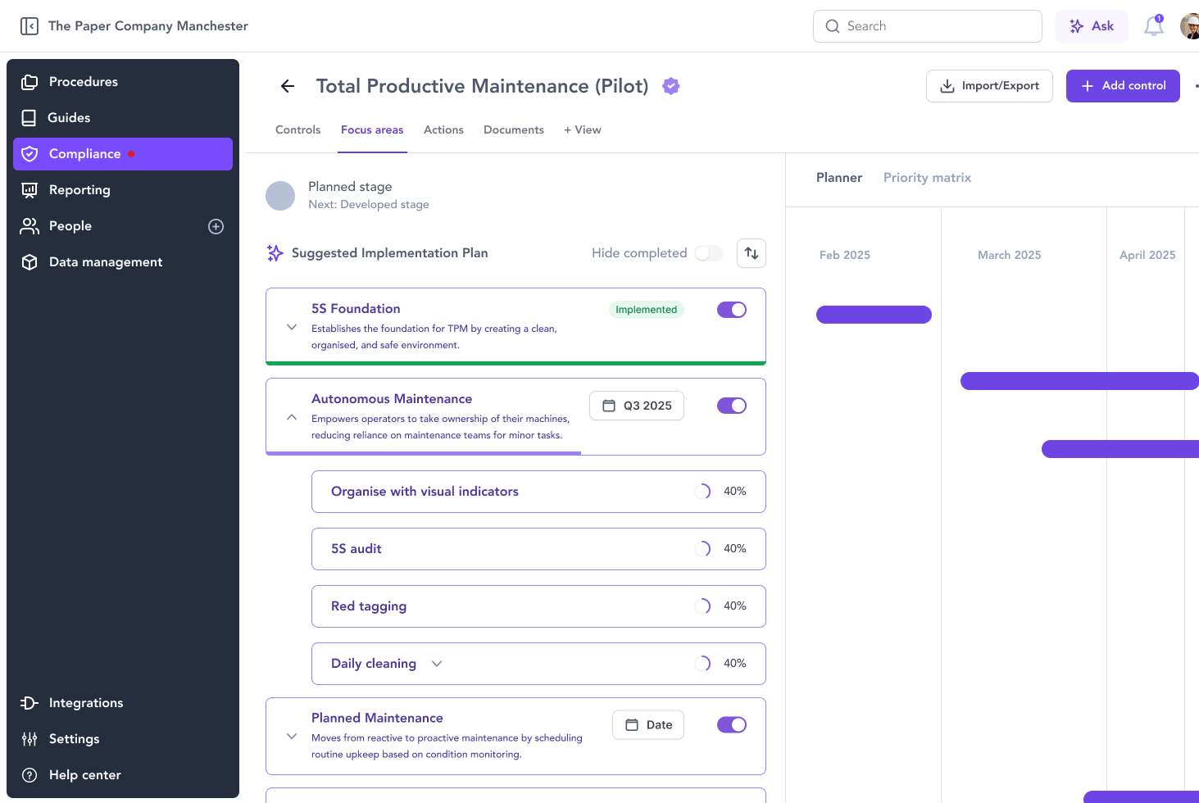
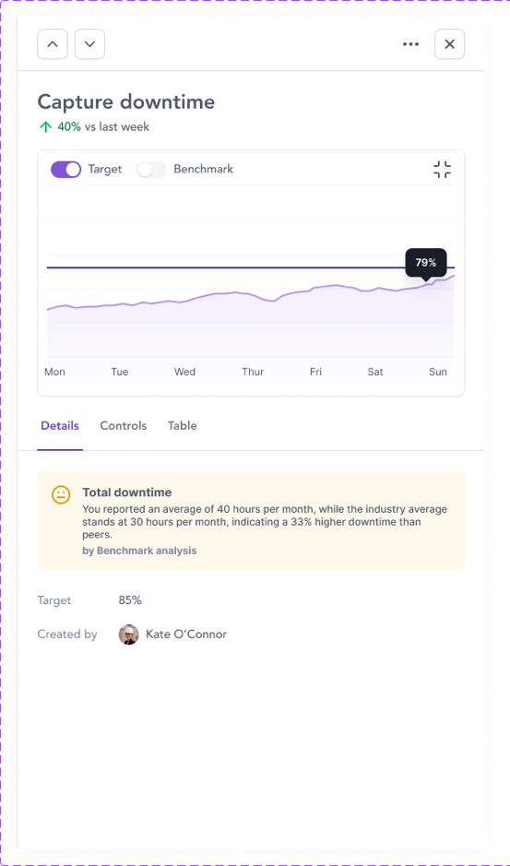
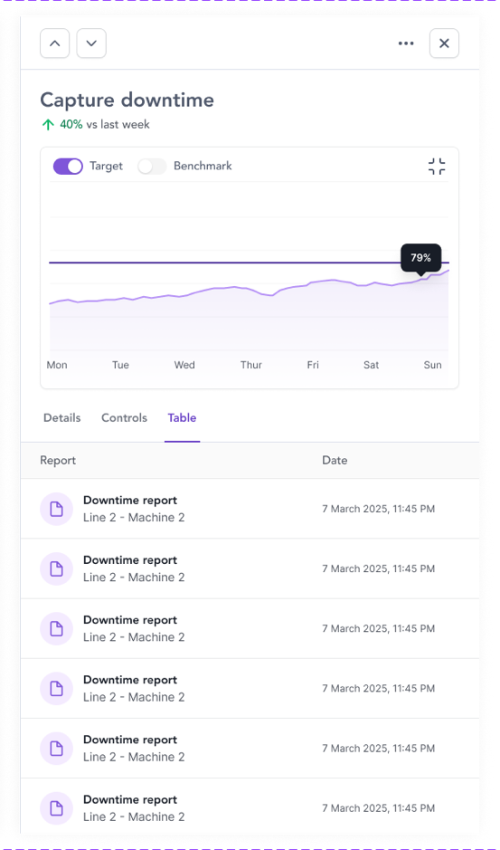
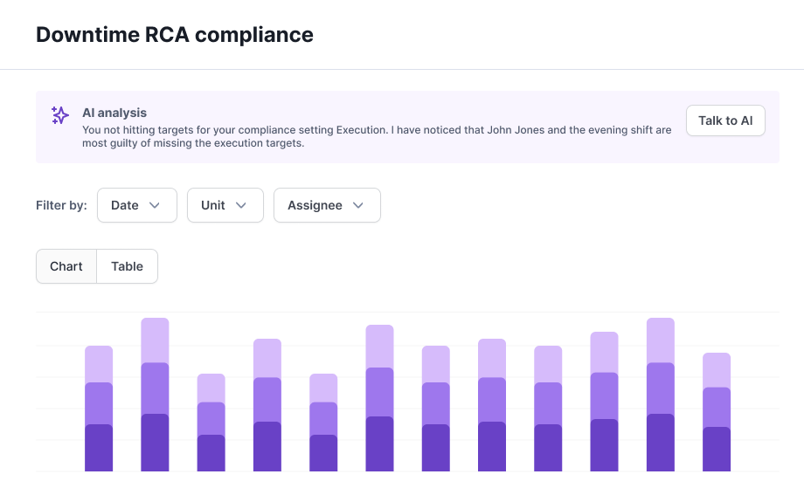
IntellectIQ Platform Dashboards

Slide 17

The Next Stage of Manufacturing Excellence with IntellectIQ Platform
Execution is continuously monitored
Systems that learn from performance
Standards that evolve automatically
Humans in the loop and AI-powered at every step
QMS and frontline operations give real-time control over production and compliance

Slide 18

Thank You!
[NAME]
[TITLE]
[Email]

